Slide 1
The strategic value of IT
Lecture 3 – Internal analysis

Slide 2
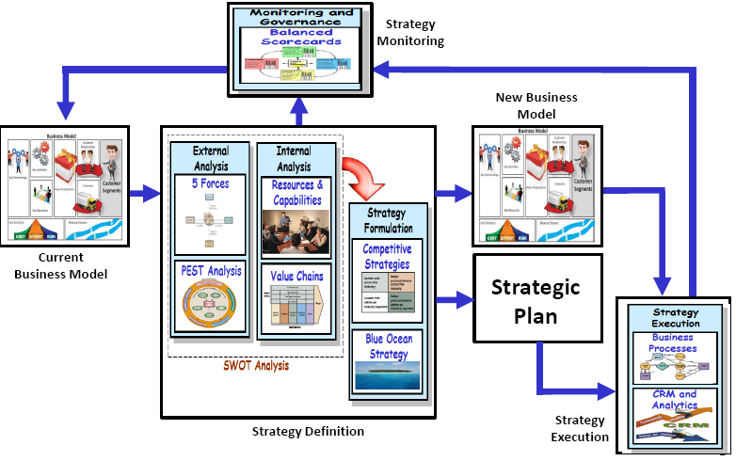
The Strategic flow

Slide 3
Internal analysis two strategic landscape
Value Chain
Resource Based View (RBV)

Slide 4
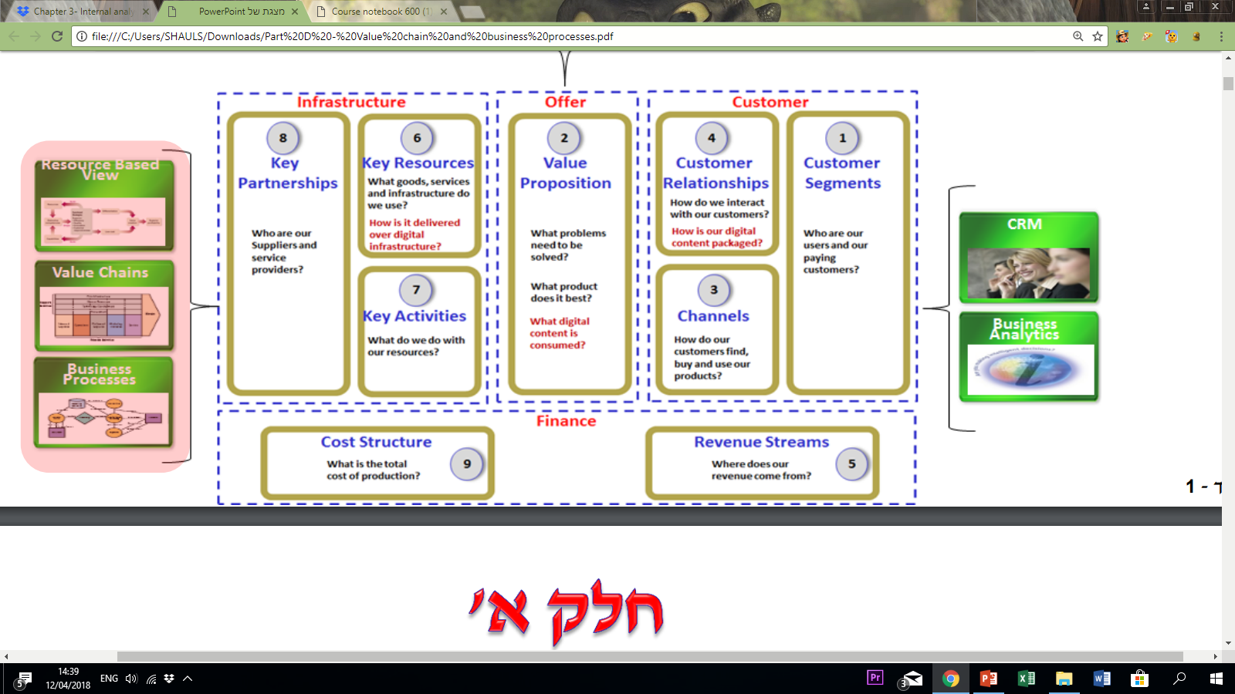
It and the value chain

Slide 5
Value chain model

Slide 6
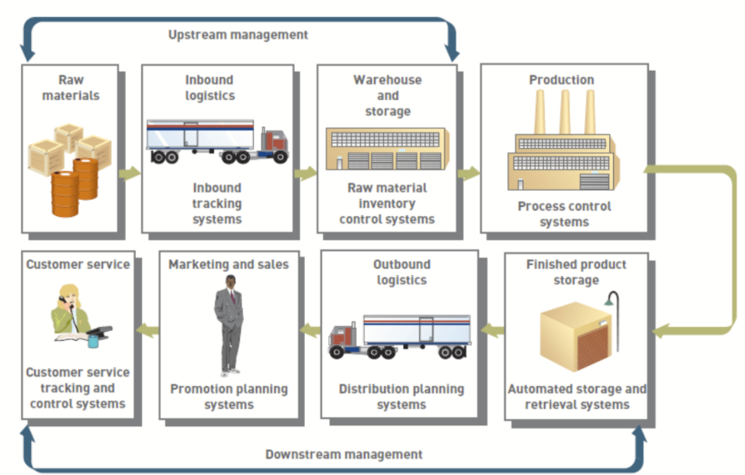
The stream of the value chain

Slide 7
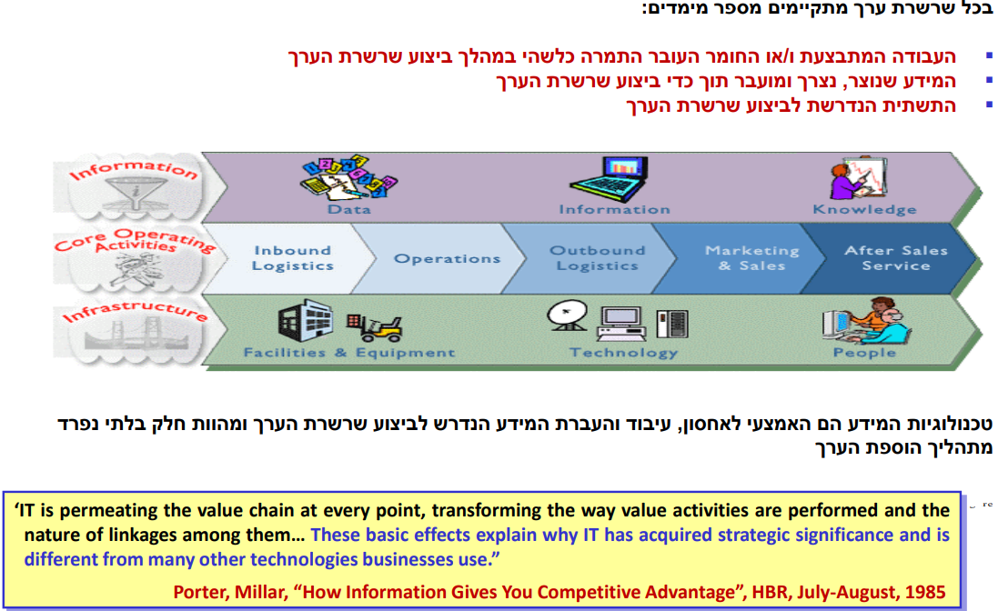
It as a core component of the value chain

Slide 8
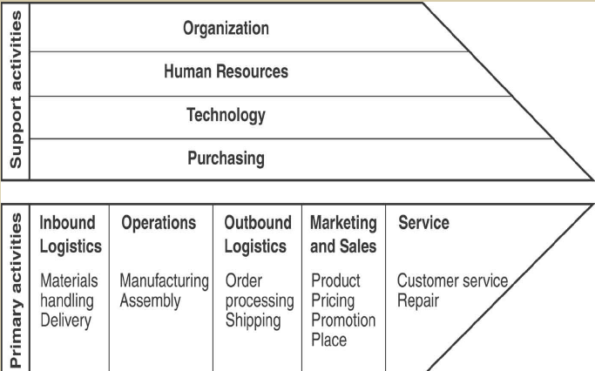
Value chain model

Slide 9
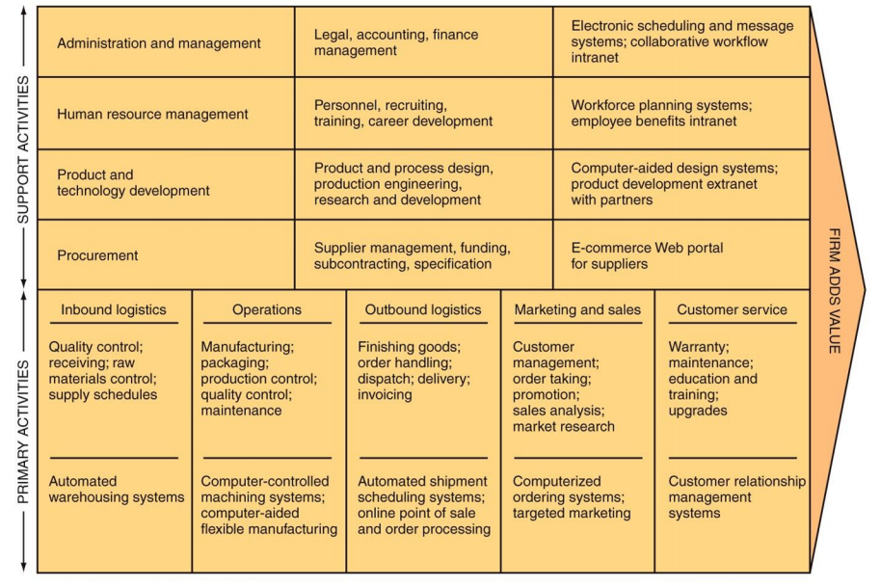
Value chain model Activities

Slide 10
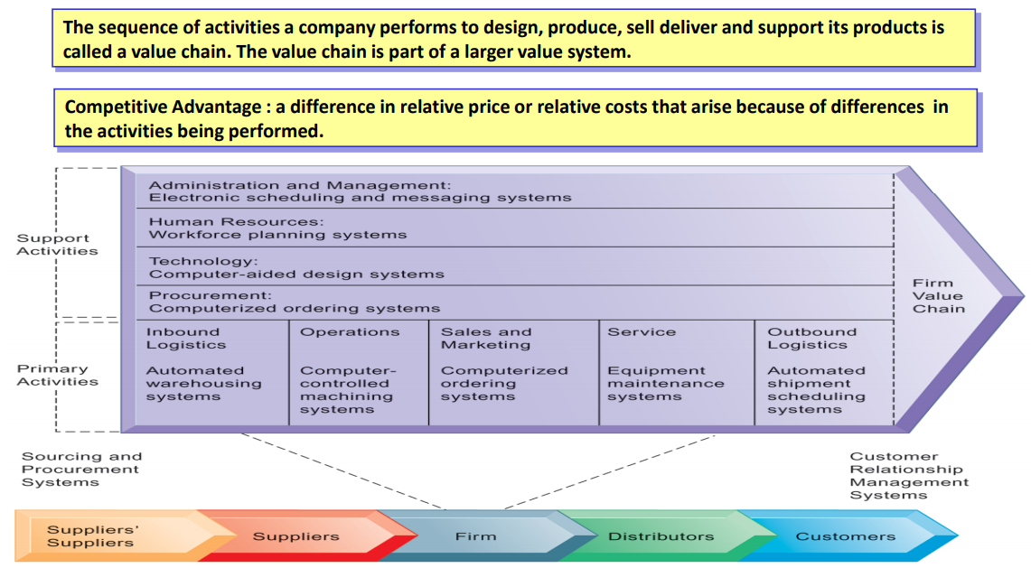
It embedded in the value chain
Up stream
Down stream

Slide 11
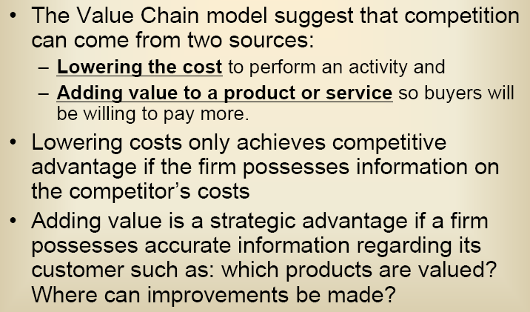
Value chain model Information resource

Slide 12
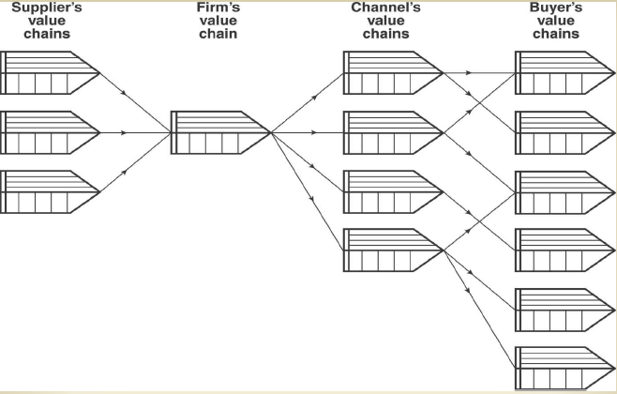
Value chain system inter-connecting relationships between organizations

Slide 13
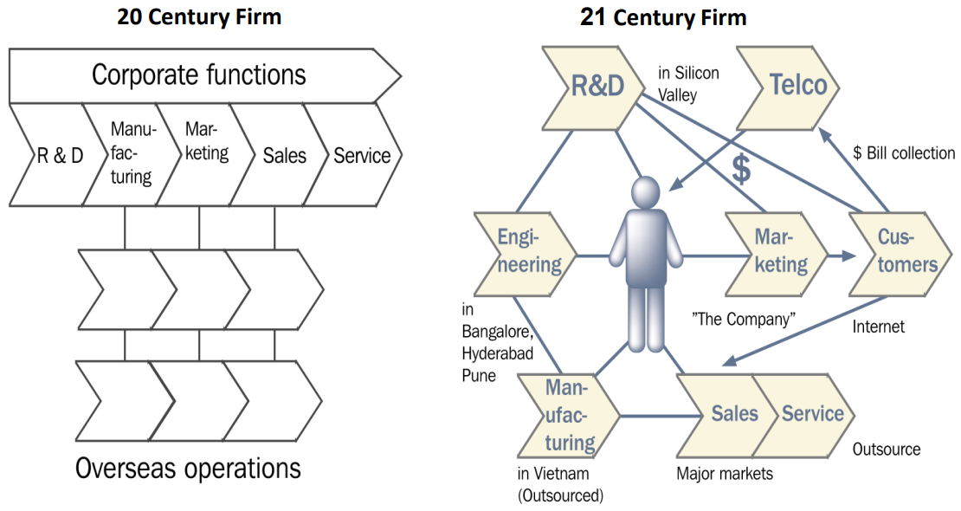
Globalization of the value chain
Notes:
שרשרת ערך קשיחה יחסית לעומת רשת ערך מורכבת וגלובלאלית

Slide 14
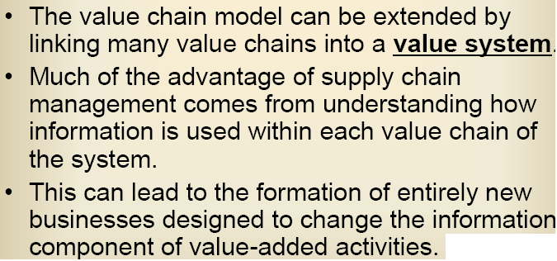
Value chain system inter-connecting relationships between organizations

Slide 15
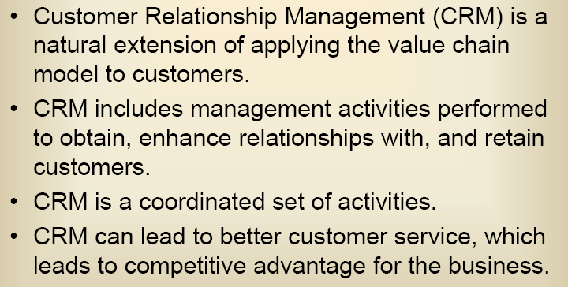
Crm & the value chain

Slide 16
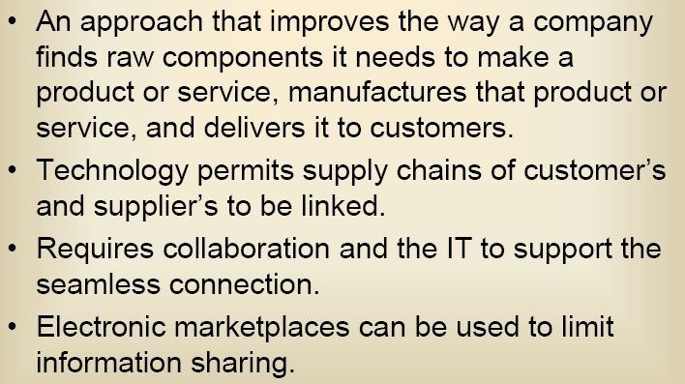
Srm & the value chain

Slide 17
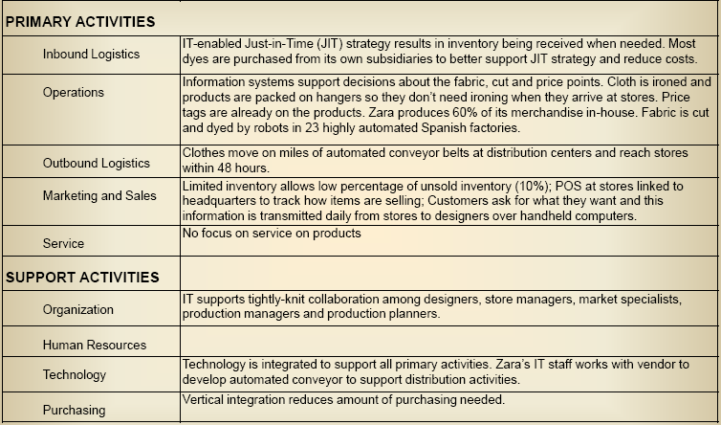
Zara’s activities

Slide 18
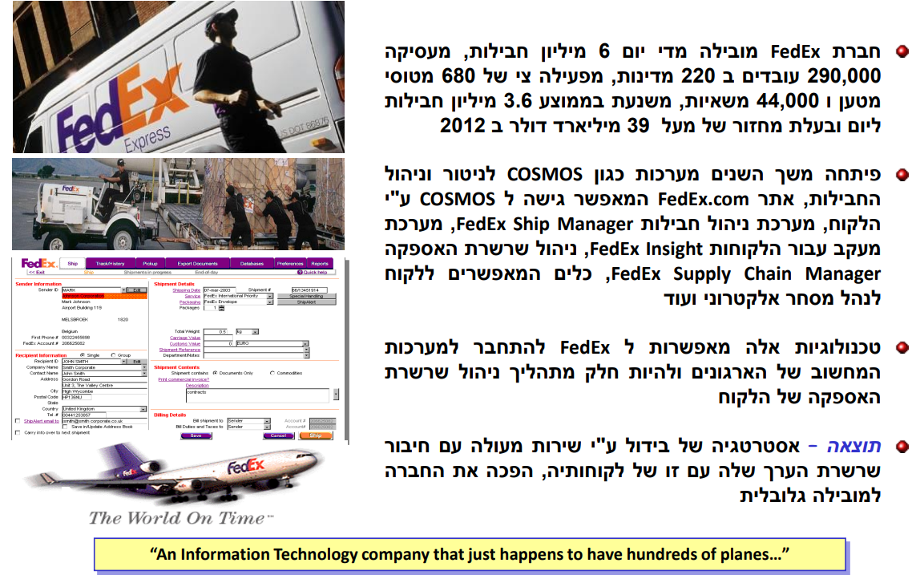
fEdex

Slide 19
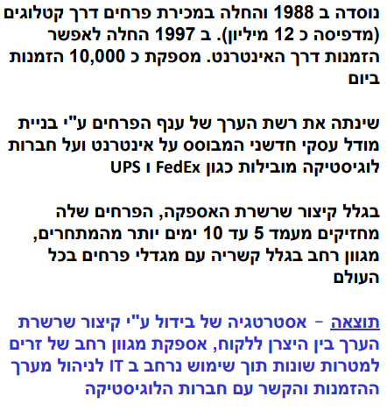
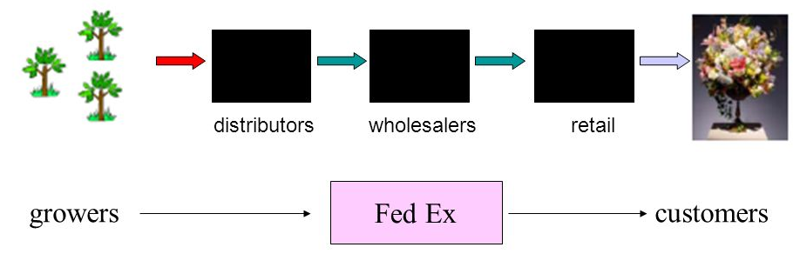
calyx

Slide 20
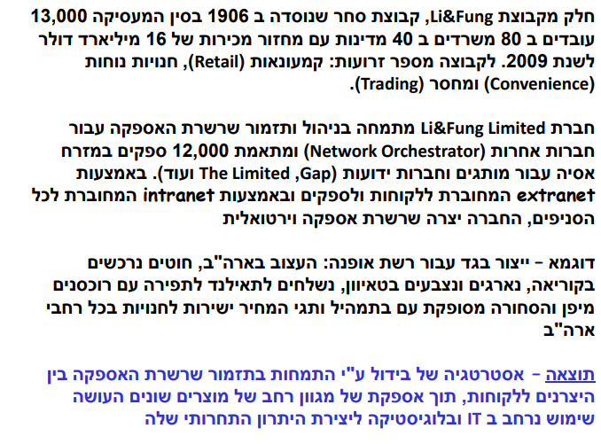
Li & fung

Slide 21
Resources & capabilities model

Slide 22
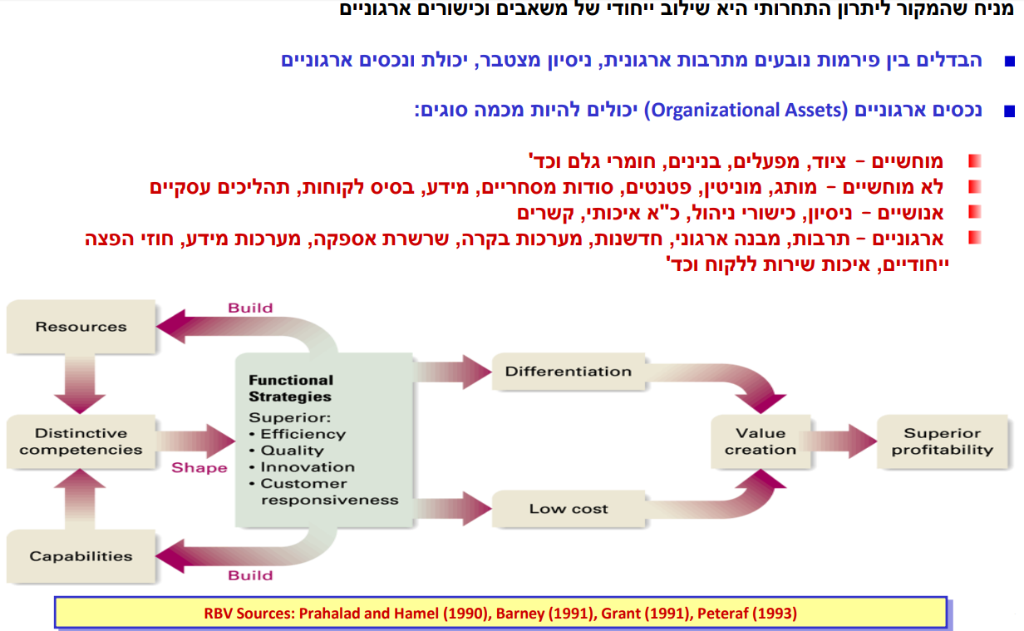
Resources & capabilities model

Slide 23
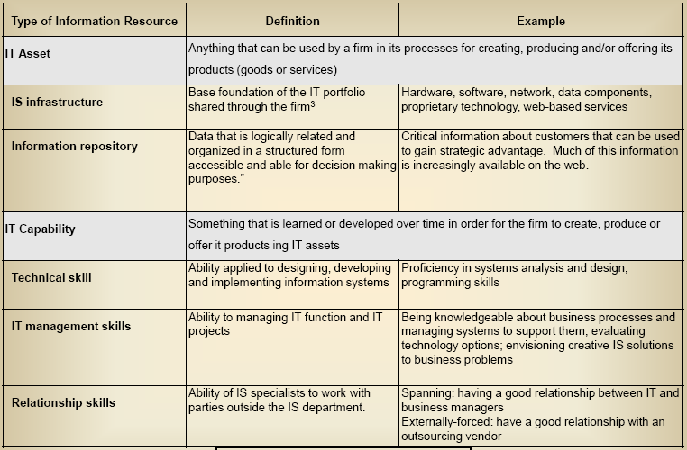
Resources & capabilities model

Slide 24
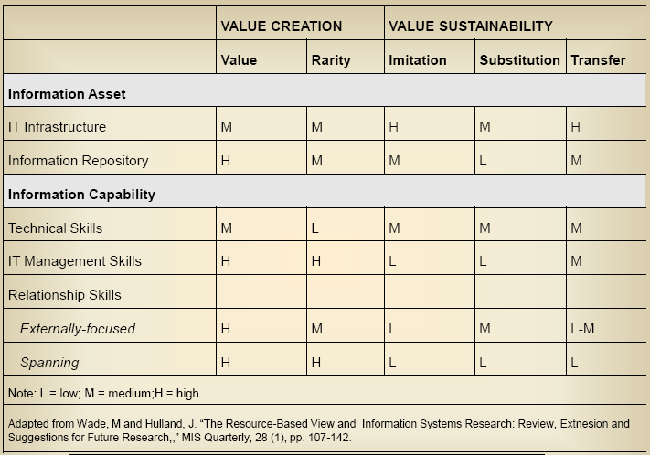
Information resources at zara

Slide 25
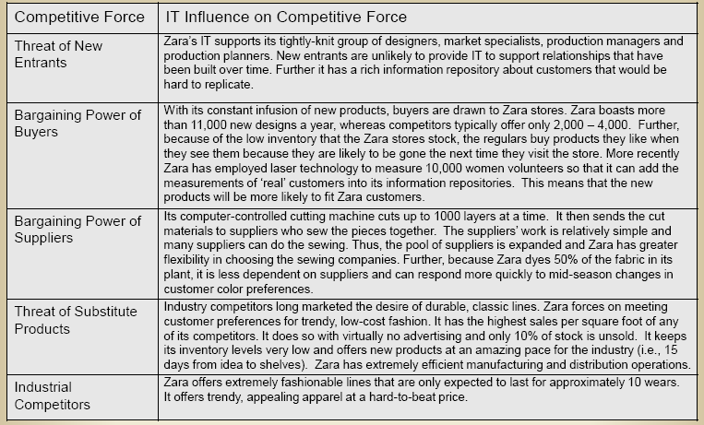
Resources & capabilities model

Slide 26
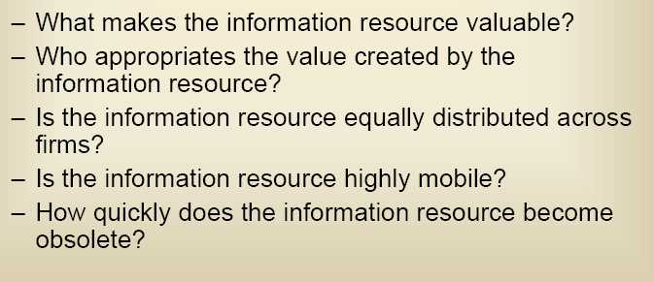
Resources & capabilities model critical questions

Slide 27
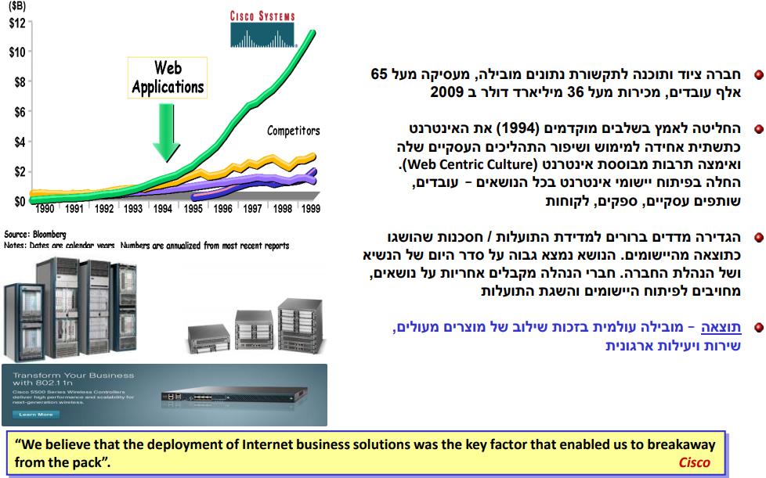
cisco

